Slide 1
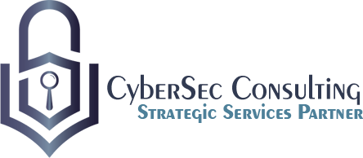
Workshop – IAM and PAM
^{15th May 2023}

Slide 2
Introduction
Ravneet Singh Bedi
Director – IAM Practice
CyberSec Consulting Dubai

Slide 3
Agenda
Introduction
1
IAM Fundamentals
2
PAM Fundamentals
3
IAM and PAM Integration
4
Common Challenges
5
Case Study
6
Conclusion
7

Slide 4
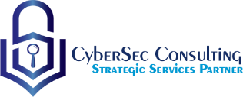
Introduction

Slide 5
Introduction to Workshop
Educating participants on the basics of IAM and PAM, their importance, and how they work.
Discussing the latest trends and best practices in IAM and PAM.
Discussing IAM – PAM integration and the challenges involved.
Sharing real-world examples of how IAM and PAM have been successfully implemented in organizations, including the benefits achieved and the lessons learned.
Exploring the different IAM and PAM solutions available in the market, their features, and how to select the right solution for an organization.
Facilitating discussions and brainstorming sessions to help participants identify the IAM and PAM challenges they face in their organizations and possible solutions.

Slide 6
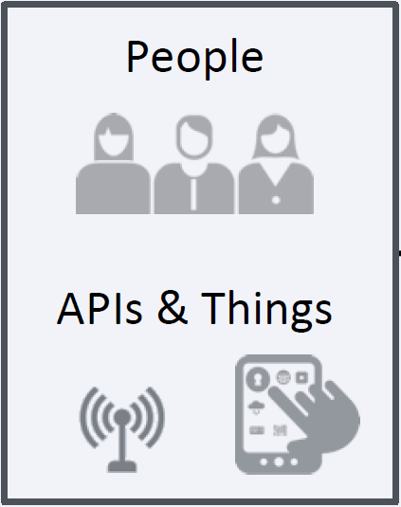
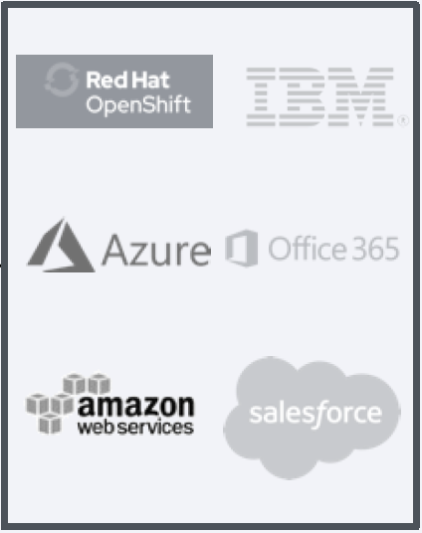
Introduction – Domain (IAM)
IAM Domains
Identity Governance and Lifecycle
Provision | Certify | Analyze
Access Management
Authenticate | Authorize | Connect
Privilege Access Management
Monitor | Detect | Orchestrate

Slide 7
IAM Fundamentals

Slide 8
Definition of IAM
People
Process
Technology
What is IAM:
IAM manages identities and controls who has access to what.
IAM enforces policies and provides authentication and authorization mechanisms.
IAM automates user lifecycle management, including onboarding offboarding and certification among other use cases.
IAM improves security and compliance by reducing the risk of unauthorized access and data breaches.
“Who has access to what Systems or Applications and Why?”
“Only the right people have access to right resources”
IAM follow the methodology of people, process and technology as the best-practice approach to understand our customer’s identity challenges, identify critical pain-points that can be prioritized based on their severity

Slide 9
Components of IAM
Identity Governance
Compliance Management
Access Management
Role Management
Access Request Management
Identity Provisioning
Identity and Access Management

Slide 10
Benefits of Strong IAM Program
Enhanced security
Improved compliance
Cost savings
Better user experience
Reduced risk of insider threats:
Increased efficiency, Flexibility and Scalability
Centralized management

Slide 11
PAM Fundamentals

Slide 12
Definition of PAM
People
Process
Technology
What is PAM:
PAM secures privileged accounts.
PAM controls access and enforces policies related to privilege access.
PAM automates management of privileged accounts.
PAM reduces security risks.
“Stay in control of your organization's most valuable assets”
“Fortify your security defenses by locking down your most powerful accounts and assets with Privileged Access Management (PAM).”
PAM follow the methodology where it involves all people, processes and technology same as IAM, however it places a greater emphasis on the technology aspect due to the criticality of securing privileged access.

Slide 13
Components of PAM
Privileged Session Management
Privileged Access Governance
Application-to-Application Password Management
Privileged Account Discovery
Privileged Account Management
Secrets Management
Privileged Access Management

Slide 14
Benefits of Strong PAM Program
Prevent Account Takeover Attacks
Reduce Malware Infection
Increase Visibility Of Privileged Users And Accounts
Reduce The Risk Of Standing Privilege
Stay Compliant
Accountability
Visibility

Slide 15
IAM - PAM Integration

Slide 16
IAM + PAM Use Cases
Desktop Security
Manual Admin Process
Variety of Devices
Business User Password Management
Personal Credentials
Sensitive Information
Protecting High-Risk Sessions
Multiple Risk Sources
Limited Audit and Monitoring
Privileged User Lifecycle Management
User Management Complexity
Lack of Visibility
End Point Focused Attacks
Poor Credential Security
Shifting Risk Profiles
Excess Permissions

Slide 17
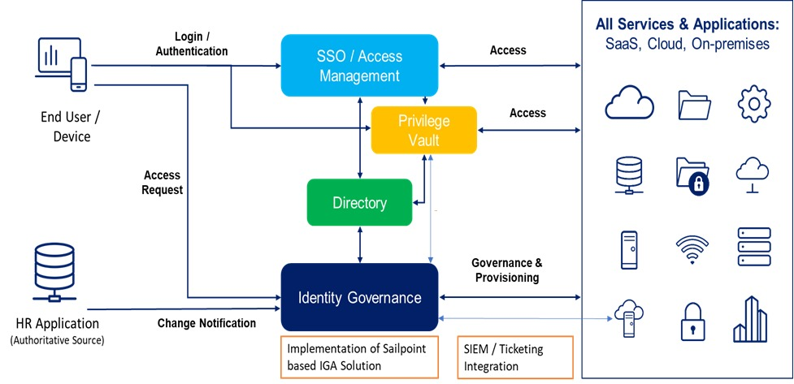
High Level IAM + PAM Architecture

Slide 18
Identity Lifecycle Scenario
Name: John Wilson
Identity Type: Contractor
Identity Type: Employee
Department: Finance
Department: IT
On- Prem Applications and Resources
Cloud Apps
Finance Apps & folders
IT Apps & folders
Server access
Contractor
(Joiner)
Become
Employee
Promotion
(Mover)
Change of
Department
(Mover)
Resign
(Leaver)
Rejoin
(Joiner)
Retire
(Leaver)
Access
Permissions
Timeline
Notes:
Tell them this is a current access.

Slide 19
Best Practices of IAM and PAM Integration
Define clear roles and responsibilities for IAM and PAM teams
Clearly define who is responsible for managing identities and access rights, and who is responsible for managing privileged access
Foster collaboration between the teams to ensure consistency in policies and processes
Establish a common data model and taxonomy
Establish a common vocabulary for identity, roles, and privileges
Ensure consistency in data formats and definitions across IAM and PAM solutions
Leverage a common identity store
Implement a common directory service for users and privileged users
Ensure that both IAM and PAM solutions are integrated with the same directory service
Implement single sign-on (SSO) for all users
Enable seamless access to all systems and applications
Reduce complexity and increase efficiency for users and administrators
Use a unified policy engine
Define access policies and rules for both IAM and PAM in one place
Ensure consistency in policy enforcement across all systems and applications
Implement a strong authentication mechanism for privileged access
Use multi-factor authentication (MFA) for all privileged accounts
Use temporary access credentials where possible
Implement just-in-time (JIT) provisioning and deprovisioning of privileged accounts
Ensure that privileged accounts are only created when needed
Automatically remove privileges when no longer required
Monitor and analyze privileged activity
Use real-time monitoring and analytics to detect potential security threats
Implement alerts and automated response mechanisms to mitigate risk
Regularly assess and audit IAM and PAM solutions
Evaluate the effectiveness of IAM and PAM policies and procedures
Identify areas of improvement and implement changes as necessary
Provide regular training and awareness
Ensure all users and administrators understand the importance of IAM and PAM
Foster a culture of security awareness and best practices.

Slide 20
Common Challenges and Filling Gaps

Slide 21
Common Challenges of IAM and PAM Integration
Lack of alignment between IAM and PAM policies
May result in inconsistent access policies
May cause confusion among users and administrators
Siloed IAM and PAM solutions
May lead to unnecessary complexity and inefficiencies
May cause difficulty in maintaining compliance and auditing requirements
Difficulty in managing privileged access
May lead to mismanagement of sensitive data and systems
May cause regulatory and compliance risks
Inadequate identity governance and administration
May cause ineffective management of user identities and access
May cause inconsistencies in access policies and enforcement
Limited visibility and control over privileged access
May result in insufficient monitoring and auditing
May cause difficulty in detecting and responding to privileged access abuse
Insufficient user education and training
May lead to users not following IAM and PAM policies and procedures
May cause increased risk of security breaches
Lack of collaboration between IAM and PAM teams
May cause delays in implementing changes or addressing issues
May lead to siloed solutions and inconsistent access policies
Inability to adapt to changing business needs and technologies
May cause ineffective IAM and PAM solutions
May lead to security risks and compliance issues

Slide 22
Overcoming Gaps!
Develop a comprehensive IAM and PAM architecture
Align with security policies and regulatory requirements
Identify and address gaps and inconsistencies
Establish a centralized identity and access management system
Integrate with PAM for a seamless experience
Reduce complexity and ensure consistent access policies
Conduct regular audits and assessments
Identify areas of improvement and ensure compliance
Ensure effective and efficient IAM and PAM solutions
Implement just-in-time (JIT) provisioning and deprovisioning of privileged accounts
Reduce risk of orphaned accounts and unauthorized access
Ensure only those who require privileged access are granted access
Use multi-factor authentication (MFA) for privileged access
Ensure strong authentication and reduce risk of compromised credentials
Detect and prevent unauthorized access attempts
Monitor and analyze privileged activity
Detect and respond to anomalies, suspicious behavior, or policy violations
Ensure privileged access is used appropriately
Provide regular training and awareness
Raise awareness of the importance of IAM and PAM
Ensure all users understand risks and follow best practices
Work with experienced vendors and partners
Provide necessary expertise, resources, and support
Overcome gaps and challenges in IAM and PAM integration.

Slide 23
Case Studies

Slide 24
Case Study - 1
The Context
Regional healthcare organization which supports more than 8,000 workers and is the single-largest employer in the region.
Key Challenges before Implementation
- No central view of users and privileges and Lack of a managed identity life cycle.
- No standard approval workflow for access requests.
- Access to privileged account passwords was not audited, passwords were not consistently rotated and Privileged Sessions were not Managed.
The Project
The Results
Organization deployed SailPoint IdentityIQ (IIQ) to merge identity governance and administration efficiently through a single interface
IIQ provided the foundation for enforcing policy and provisioning user data into critical applications such as Active Directory, SAP among others
Organization selected CyberArk’s Privileged Access Solution (PAS) to enhance their security posture and audit use of privileged accounts
Organization deployed CyberArk’s Privileged Session Manager (PSM) for visibility and efficiency to avoid administrative disruption
PSM enabled the organization to create Remote Desktop (RDP) shortcuts for administrators, which allowed them to use native connection tools with PSM automatically handling checking out privileged credentials from a safe and auditing all activities during the session
Combination of integrated PAM and IGA solutions delivered day one productivity for new employees using familiar tools
Integration required far fewer people and time to perform both simple and complex job changes, including revoking access when privileged users leave the organization
Organization was able to achieve Central Identity management with management of complete User Life Cycle using IGA tool while Fulfilling Compliance Requirements.
After implementing PAM Organization was able to manage privileged accounts, which included accounts for IT administrators, database administrators, and other users with elevated privileges. Using a JIT (Just-In-Time) approach to provision and deprovision privileged accounts, which reduced the risk of unauthorized access to critical systems and data.
Were able to achieve real-time monitoring and analytics to detect potential security threats, including anomalous user behavior and access patterns. This allowed them to quickly respond to security incidents and prevent data breaches.

Slide 25
Case Study - 2
The Context
Financial institution with approximately 600 employees in its Head office, serves more than 100 organizations. It’s now fairly mature in its identity and access management, with both IGA and PAM solutions.
Key Challenges before Implementation
Over-abundance of unmanaged Active Directory groups, which stressed the authorization process
Access to privileged account passwords was not audited, passwords were not consistently rotated and Privileged Sessions were not Managed.
No auditable process for requesting access and approval workflows
The Project
The Results
Organization implemented an integration between SailPoint and CyberArk that could provide proper governance for requesting, approving, provisioning/deprovisioning, and certifying privileged accounts and safe permissions
Organization created a workflow that adds safe permissions for identities in CyberArk that are viewed and maintained in IIQ
Integration gave a centralized view into safes, and a unified way to add permissions and perform certifications
Organization selected CyberArk’s Privileged Access Solution (PAS) to enhance their security posture and audit use of privileged accounts
Organization deployed CyberArk’s Privileged Session Manager (PSM) for visibility and efficiency to avoid administrative disruption
PSM enabled the organization to create Remote Desktop (RDP) shortcuts for administrators, which allowed them to use native connection tools with PSM automatically handling checking out privileged credentials from a safe and auditing all activities during the session
Organization switched from unmanaged AD Groups to Direct Authorization at Application level where SailPoint IIQ helped them to manage them in centralized and secured Manner.
Organization was able to achieve Central Identity management with management of complete User Life Cycle using IGA tool while Fulfilling Compliance Requirements.
Organization moved from Active Directory groups to direct management, where it increased transparency into certifications inside IGA system.
Organization achieved deeper visibility and control with IGA and PAM that which has access to what and how access is utilized & managed.

Slide 26
Conclusion

Slide 27
Key Takeaways
IAM and PAM are critical components of an organization's security posture.
They should be integrated together to provide a comprehensive approach to access management.
IAM manages user identities and their access to resources, while PAM manages privileged accounts and their access to critical systems and data.
Strong IAM and PAM programs improve security posture, provide increased visibility and control, and ensure compliance with regulatory requirements.
Best practices for integrating IAM and PAM include implementing a phased approach, integrating with other security technologies, establishing clear policies and procedures, and providing regular training to users.
Common challenges of IAM and PAM integration include siloed approaches, lack of visibility into privileged access, and difficulty in managing multiple systems.
Real-world case studies, provide insights into successful IAM and PAM programs.
Lessons learned from implementing IAM and PAM include tailoring the program to meet specific security and compliance requirements, providing regular training, and continuously monitoring and updating the program to stay ahead of emerging threats.

Slide 28
Q&A

Slide 29
THANK YOU
www.cybersecit.net

